Slide 1
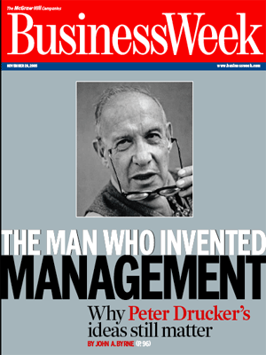
TOPIC 11 BASIC CONCEPTS OF MANAGEMENT AT THE ENTERPRISE AND ITS FUNCTIONS.
1. The concept of management.
2. Subject of study.
3. General management functions.

Slide 2
management:
- way, manner of dealing with people;
- power and art of management;
- a special kind of skill and administrative skills;
- governing body, administrative unit.

Slide 3
The subject of research in management theory is the economic behavior of people in their joint activities and the motivational mechanism of this behavior.
In management, a system means an internal organized totality or a combination of interconnected, relatively independent constituent elements of parts that form a complex unified whole.

Slide 4
Management is characterized by:
- the presence of the system;
- the presence of a causal relationship between elements in the system;
- the presence of a control and controlled subsystems;
- dynamic character and self-development, self-regulation of the system;
- the presence of a control parameter;
- the presence of hierarchy and the construction of the control system;
- the presence of a number of other elements and connections.

Slide 5
The main goal of the enterprise is to create certain goods and services within the framework of restrictions - in terms of costs and profit.
As a result of the division and specialization of managerial labor, a management function arises. The function occupies a key place in the system of the main categories of management.

Slide 6
Management functions are special types of activity expressing the directions or stages of the implementation of a targeted impact on the connections and relationships of people in the production process and its management.
The system of management functions is a complex of interrelated in time and space types of activities carried out by the subject of management with a targeted impact on one or another object.

Slide 7
General management functions:
- planning is a stage of the management process, at which the objectives of the activity, the necessary means for this, are determined, and the methods that are most effective in specific conditions are developed;
- organization - this is the stage of forming the structure of the organization, as well as providing everything necessary for its normal operation - personnel, materials, equipment, buildings, funds;

Slide 8
- motivation is an activity aimed at activating people working in an organization and encouraging them to work effectively to fulfill the goals set in the plans;
- control is a management activity, the task of which is a quantitative and qualitative assessment and accounting of the results of the organization's work;
- coordination is the central function of the management process, ensuring its smoothness and continuity.

